Slide 1





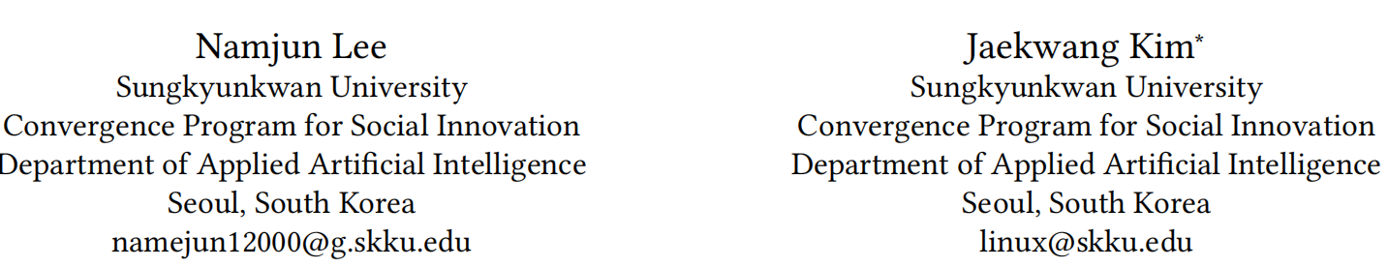





ATAI
Advanced Techniqueof Artificial Intelligence
ATAI
ChongqingUniversity _{AdvancedTechniqueof}
of Technology Artificial Intelligence
Chongqing University of
Technology
Chongqing University ^{ATAI}
_{of Technology} Advanced Techniqueof
Artificial Intelligence
Chongqing University of Technology
Chongqing University of Technology
SEALR: Sequential Emotion-Aware LLM-Based Personalized
Recommendation System
SIGIR—2025
Reported by ZhiWei Xu
1

Slide 2

ATAI
AdvancedTechniqueof
Artificial Intelligence
ATAI
ChongqingUniversity _{AdvancedTechniqueof}
of Technology Artificial Intelligence
ChongqingUniversity of Technology
Motivation
1. Despite these benefits, several challenges hinder the use of LLMs in sequential recommendation.High computational cost and token limitations affect real-time applicability , while hallucinations from ambiguous inputs can reduce user trust .
2. Dynamic and sentiment-driven user preferences are difficult to capture with static, parameterized models. Although recent work has fine-tuned LLMs on summarized user-item histories , such methods often overlook nuanced emotional feedback in user reviews , which is crucial for personalization .

Slide 3

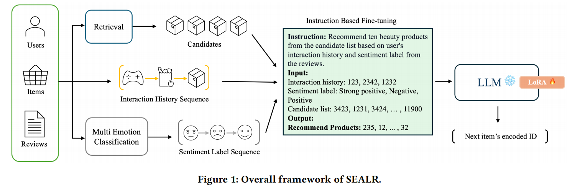
ChongqingUniversity of Technology
ATAI
AdvancedTechniqueof
Artificial Intelligence
ATAI
ChongqingUniversity _{AdvancedTechniqueof}
of Technology Artificial Intelligence
Overview

Slide 4
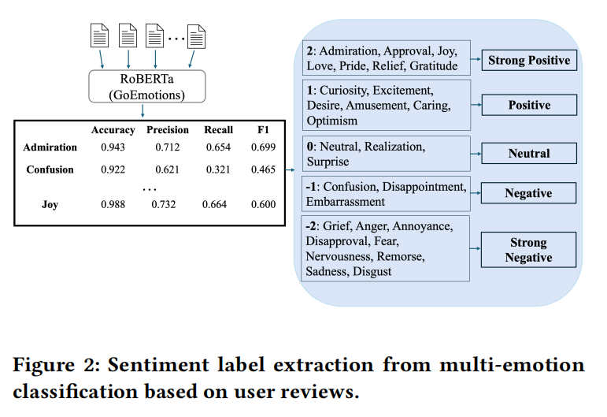
ChongqingUniversity of Technology
ATAI
AdvancedTechniqueof
Artificial Intelligence
ATAI
ChongqingUniversity _{AdvancedTechniqueof}
of Technology Artificial Intelligence
Overview

Slide 5

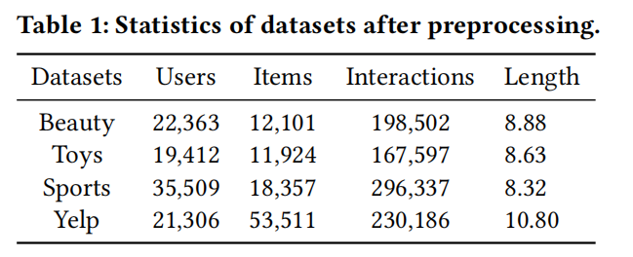
ATAI
AdvancedTechniqueof
Artificial Intelligence
ATAI
ChongqingUniversity _{AdvancedTechniqueof}
of Technology Artificial Intelligence
ChongqingUniversity of Technology
Experiments

Slide 6
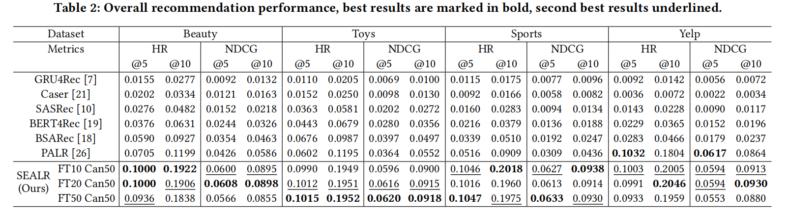
ATAI
AdvancedTechniqueof
Artificial Intelligence
ATAI
ChongqingUniversity _{AdvancedTechniqueof}
of Technology Artificial Intelligence
ChongqingUniversity of Technology
Experiments

Slide 7
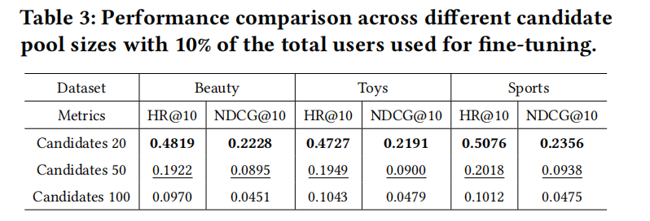
ATAI
AdvancedTechniqueof
Artificial Intelligence
ATAI
ChongqingUniversity _{AdvancedTechniqueof}
of Technology Artificial Intelligence
ChongqingUniversity of Technology
Experiments

Slide 8
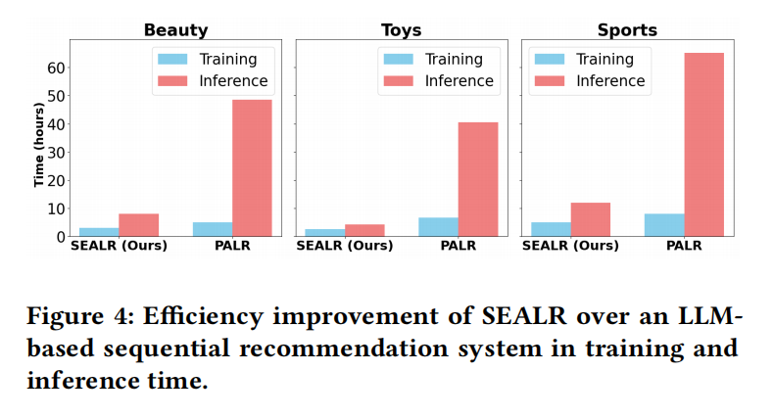
ATAI
AdvancedTechniqueof
Artificial Intelligence
ATAI
ChongqingUniversity _{AdvancedTechniqueof}
of Technology Artificial Intelligence
ChongqingUniversity of Technology
Experiments

Slide 9


ChongqingUniversity of Technology
ATAI
AdvancedTechniqueof
Artificial Intelligence
ATAI
ChongqingUniversity _{AdvancedTechniqueof}
of Technology Artificial Intelligence
Thanks!

